Slide 1
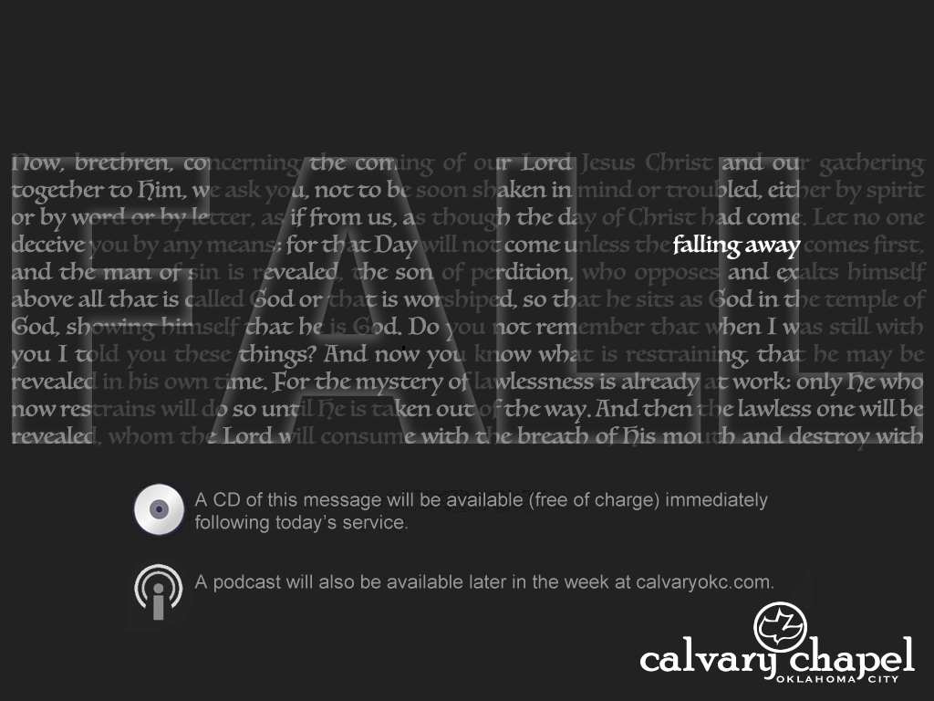
2 Thessalonians 2:9-17

Slide 2
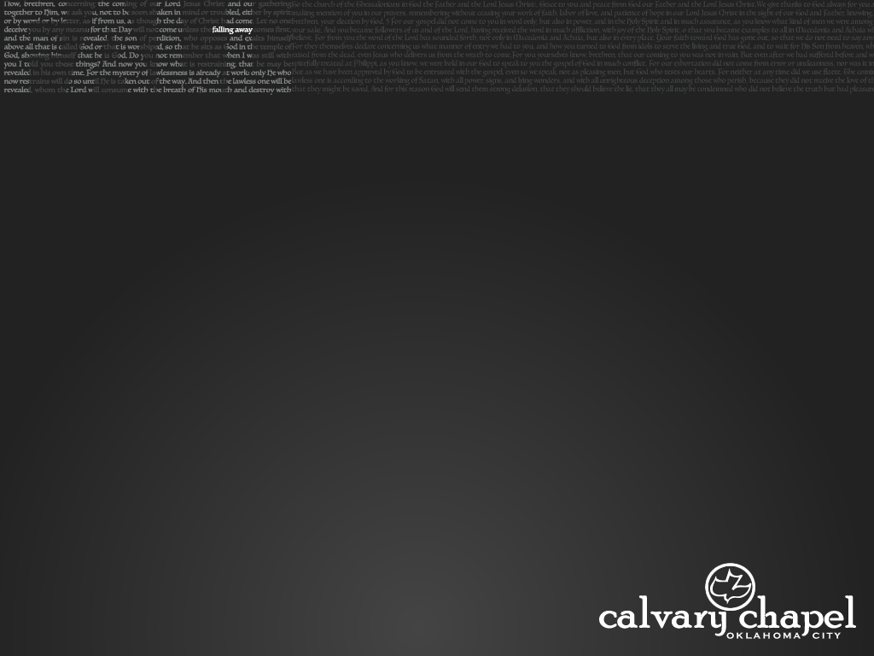
2 Thess. 2:9–17 ~ ⁹ The coming of the lawless one is according to the working of Satan, with all power, signs, and lying wonders, ¹⁰ and with all unrighteous deception among those who perish, because they did not receive the love of the truth, that they might be saved. ¹¹ And for this reason God will send them strong delusion, that they should believe the lie, ¹² that they all may be condemned who did not believe the truth but had pleasure in unrighteousness.
2 Thessalonians 2:9-17

Slide 3
2 Thess. 2:9–17 ~ ¹³ But we are bound to give thanks to God always for you, brethren beloved by the Lord, because God from the beginning chose you for salvation through sanctification by the Spirit and belief in the truth, ¹⁴ to which He called you by our gospel, for the obtaining of the glory of our Lord Jesus Christ. ¹⁵ Therefore, brethren, stand fast and hold the traditions which you were taught, whether by word or our epistle.
2 Thessalonians 2:9-17

Slide 4
2 Thess. 2:9–17 ~ ¹⁶ Now may our Lord Jesus Christ Himself, and our God and Father, who has loved us and given us everlasting consolation and good hope by grace, ¹⁷ comfort your hearts and establish you in every good word and work.
2 Thessalonians 2:9-17

Slide 5
2 Thessalonians 2:9-17

Slide 6
We’ll always get in less trouble if we interpret a figurative passage literally, than if we interpret a literal passage figuratively.
2 Thessalonians 2:9-17

Slide 7
2 Thessalonians 2:9-17

Slide 8
Sherry told me I needed to quit acting like a flamingo.
So I had to put my foot down
Then I told her that she drew eyebrows too high.
She looked surprised
Once, back in my heathen days, I bought some shoes from a drug dealer.
I don’t know what he laced them with, but I was trippin’ all day
2 Thessalonians 2:9-17

Slide 9
What’s the difference between a hippo and a zippo?
One is very heavy and the other is a little lighter
The other day I said to Scott, “What rhymes with orange?”
He said, “No it doesn’t”
I bought this really cheap thesaurus yesterday.
Not only was it terrible, it was terrible.
2 Thessalonians 2:9-17

Slide 10
Two cows were grazing in a field and one said to the other, “Do you ever worry about ‘mad cow disease’?”
The other said, “No, not me. I’m a helicopter.”
It’s hard to explain puns to a kleptomaniac.
They always takes things literally
So what if I don’t know what Armageddon means.
It’s not like it is the end of the world
2 Thessalonians 2:9-17

Slide 11
2 Thessalonians 2:9-17

Slide 12



Preterism
Paul
in Rome
Burning of Rome
Jewish/Roman war
AD 35
AD 45
AD 55
AD 65
Resurrection
Nero’s Reign
Destruction of Temple
2 Thessalonians 2:9-17

Slide 13
Prophecies about the Tribulation period:
Gen. 15:18
Zech. 12-14
Josh. 1:4
Matt. 24-25; Mark 13:5-37; Luke 21:7-36
Is. 13
Eze. 38-39
Rom. 11:25-26
Dan. 2:36-45; 7:1-28; 8:17, 25-26; 9:24-27; 11:36-12:13
1 Thess. 4:11-5:17
2 Thess. 2
Jer. 30:3-11
2 Pet. 2;10-13
Joel 2:30-32
Rev. 6-19
2 Thessalonians 2:9-17

Slide 14
3 types of Preterism:
1. “Mild” or “Soft” Preteriism
Return of Jesus is the “Christianization” of the World
2. “Partial” or “Moderate” Preterisim
Return of Jesus is yet future
3. “Full” or “Consistent” Preterisim
Return of Jesus is the judgment of the Romans
?
AD 50
AD 150
AD 250
Jewish/Roman war (AD 66-73)
Edict of Milan (AD 313)
Return of Christ?
2 Thessalonians 2:9-17

Slide 15
Held by most Preterists:
The “Great Tribulation” = Fall of Jerusalem in AD 70
The “Last Days” = “last days of Israel”
The “Antichrist” = any apostate teacher in any age
The “Beast” = Nero (and Rome in general)
The “False Prophet” = the Jewish leadership
The “Great Harlot” = Jerusalem
“Israel” = Church
2 Thessalonians 2:9-17

Slide 16
Dating of the book of Revelation is the key
Iranaeus (late 2nd century)
AD 64-67
AD 91-94
AD 60
AD 70
AD 80
AD 90
Jewish/Roman war (AD 66-73)
Domitian
(AD 81-96)
2 Thessalonians 2:9-17

Slide 17
Dating of the book of Revelation is the key
Iranaeus (late 2nd century)
Also Clement of Alexandria and Tertullian
Laodicea was destroyed by an earthquake in AD 61
Polycarp (AD 69-155): Smyrna had not heard the gospel before Paul’s death (c. AD 66)
2 Thessalonians 2:9-17

Slide 18
=
Apokalupsis
Revelation
Apocalypse
~ Unveiling
2 Thessalonians 2:9-17

Slide 19
2 Thessalonians 2:9-17

Slide 20
Fall of Jerusalem AD 70
Reformation 1517
State of Israel
1948
1400 yrs.
400
800
1200
1600
2000
Bar Kokhba Revolt
AD 132-135
Modern Zionism 19th century
2 Thessalonians 2:9-17

Slide 21
Rom. 11:25-26a ~ ²⁵ For I do not desire, brethren, that you should be ignorant of this mystery, lest you should be wise in your own opinion, that blindness in part has happened to Israel until the fullness of the Gentiles has come in.
1. It is partial
2. It is temporary
2 Thessalonians 2:9-17

Slide 22
2 Thessalonians 2:9-17

Slide 23
Is. 29:13 ~ Therefore the Lord said: “Inasmuch as these people draw near with their mouths And honor Me with their lips, But have removed their hearts far from Me,”
2 Thessalonians 2:9-17

Slide 24
2 Thessalonians 2:9-17

Slide 25
Merrihew Standard Version ~ Now may God Himself (our Lord Jesus Christ and the Father), who has loved us and given us …
2 Thessalonians 2:9-17

Slide 26
2 Thessalonians 2:9-17

